Slide 1
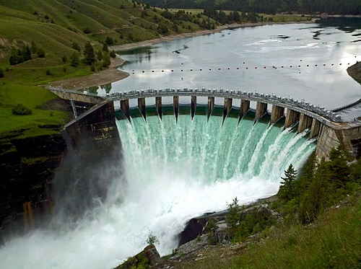
Integrating Environmental Considerations with Water Resource Simulations
Product Development Lead: Todd Steissberg (ERDC-EL)
Product Development Team:
Leila Ostadrahimi (HEC, Water Quality Lead)
Joan Klipsch (HEC, ResSim Lead)
Zhonglong Zhang (ERDC-LimnoTech)
Billy Johnson (LimnoTech)
Steve Andrews (RMA)
John DeGeorge (RMA)
Mark Jensen (HEC)
Corps District Collaboration:
Brian Zettle, TNTCX
CoP Lead, SON Proponent
Alexis Mills (NWD)
Jeff Tripe (NWK)
Erich Emery (LRD)

Slide 2
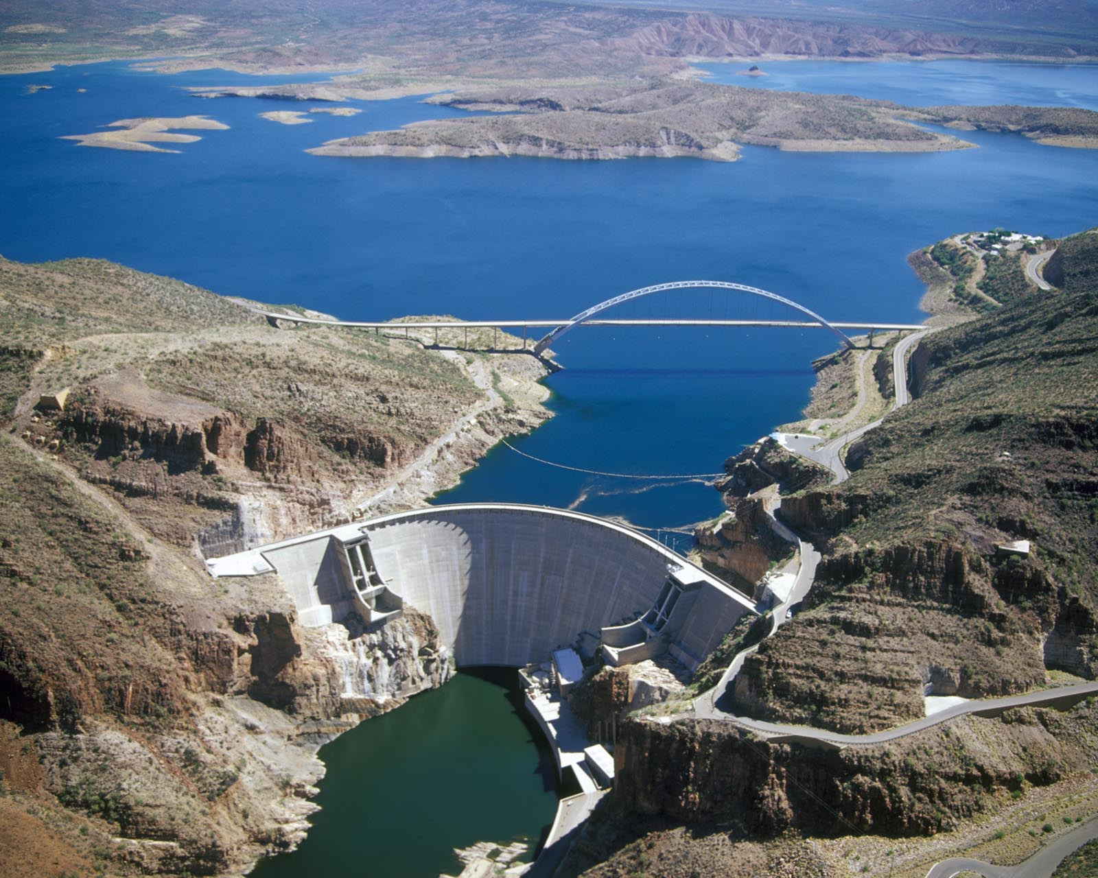

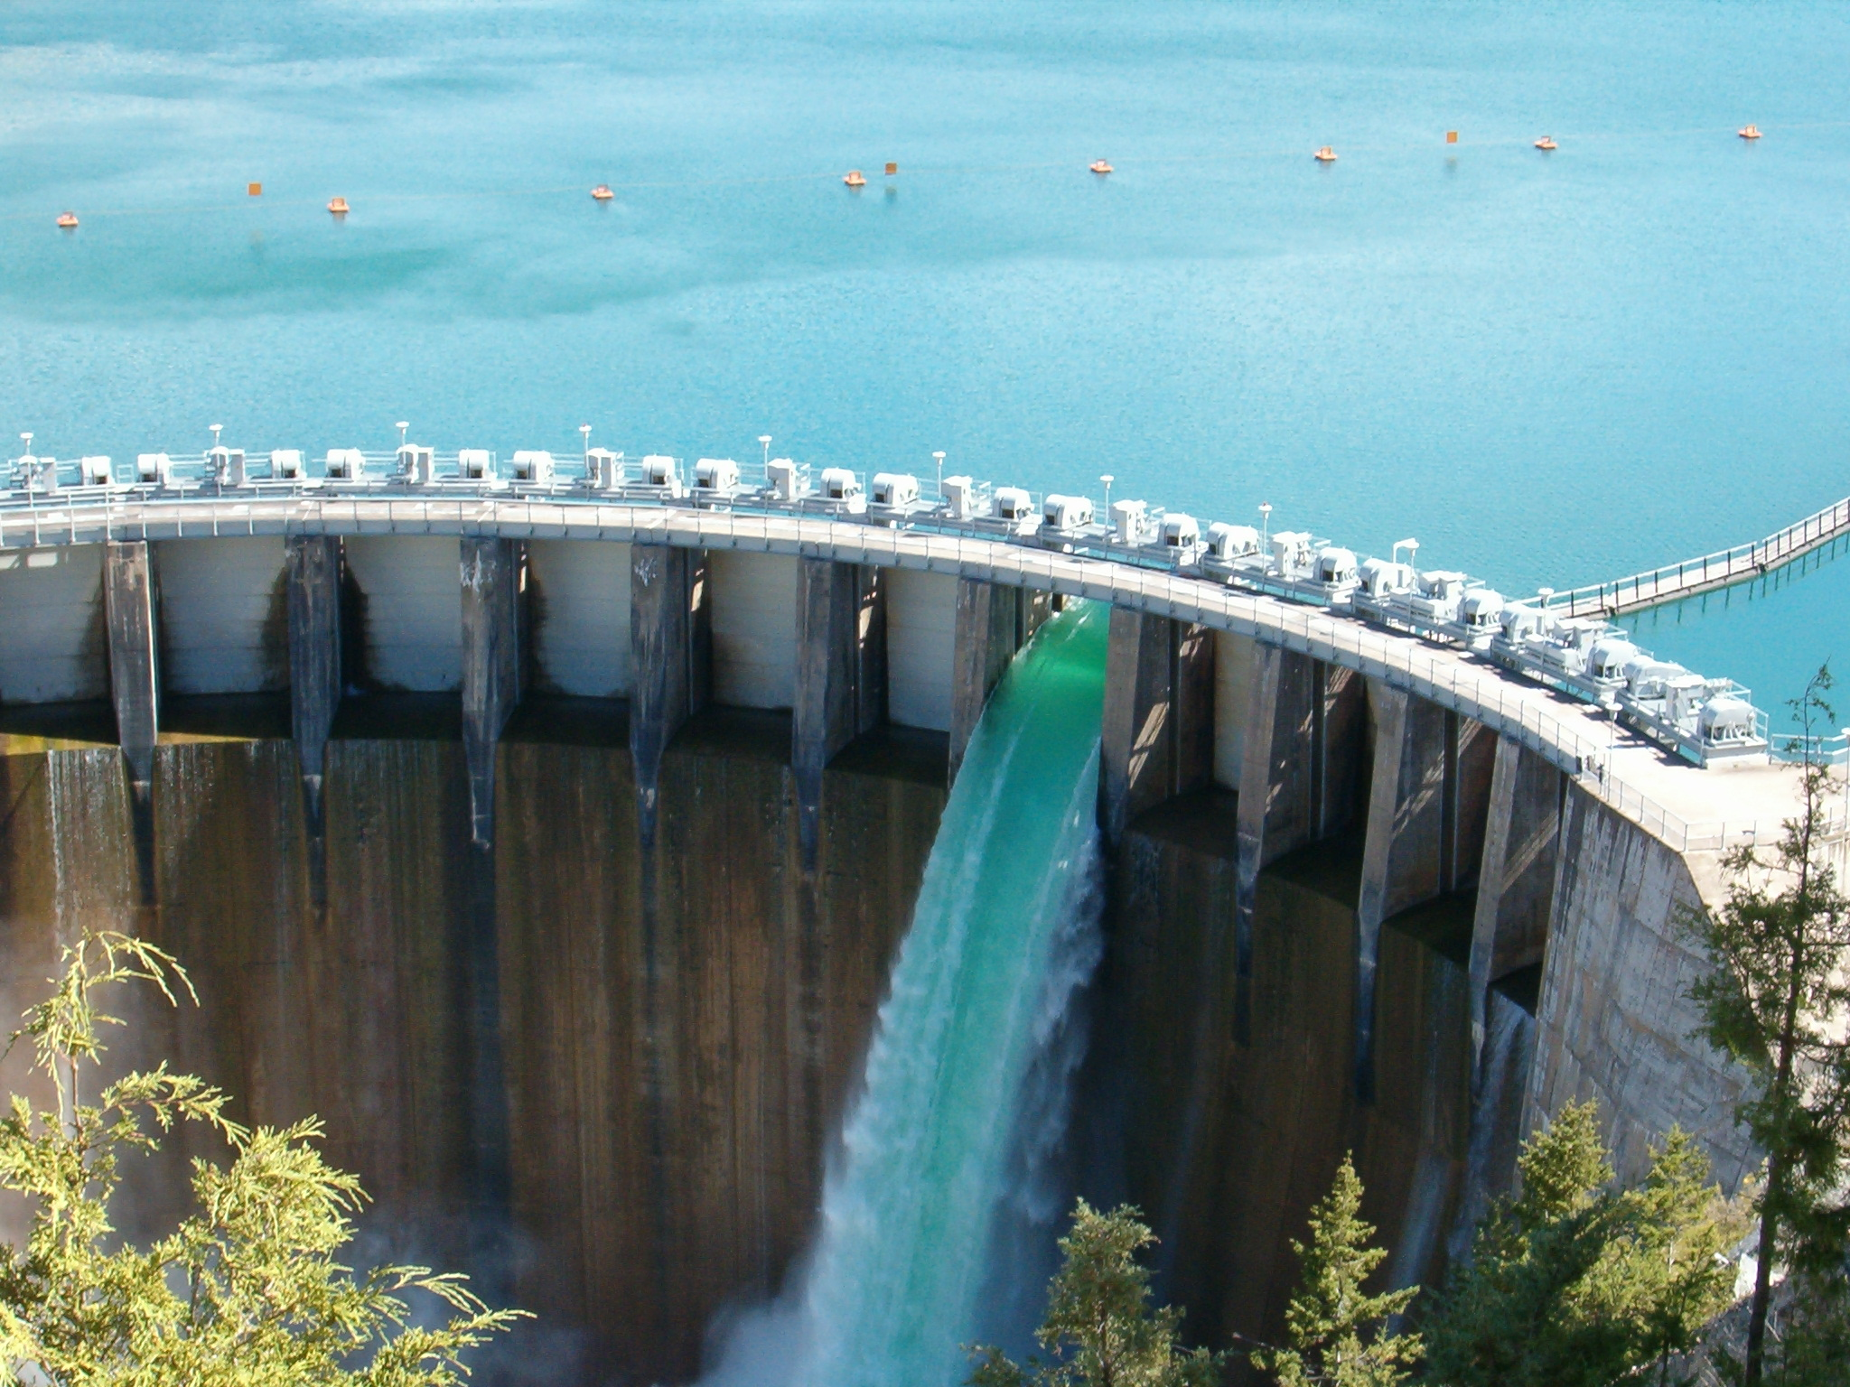
Project Purpose - Recap
SON: 2015-ER-5 Integrating Environmental Considerations with Water Resource Simulations
Need: Reservoir operations simulation software with the capability to fully integrate environmental objectives into reservoir release decision-making
Purpose: To integrate water quality modeling capabilities into HEC-ResSim, allowing water quality and related environmental objectives to directly inform reservoir release decision-making, while also providing capabilities for watershed-scale ecosystem assessment and management
Flows influence water quality
Water quality influences flows
Notes:
Keep it simple and clear. You may use a second slide if needed, however.

Slide 3
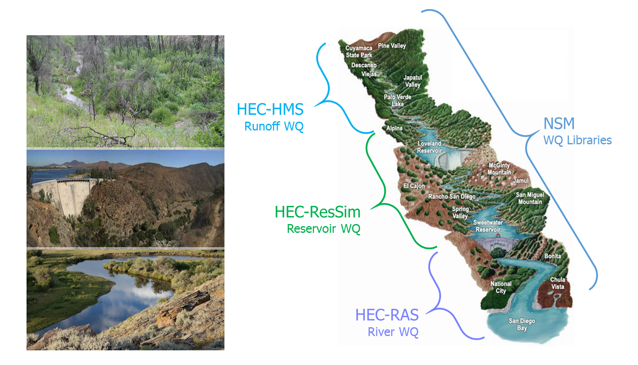
Integrated Watershed Water Quality Modeling
Temperature
Dissolved Oxygen
Primary Productivity
Nutrient Loading
Salinity
Related Analysis
Dilution
Water Age
Source Water Fingerprinting
Habitat Characterization
Models linked via:
CWMS: Real-time operations decision-making
HEC-WAT: Planning studies
Notes:
Keep it simple and clear. You may use a second slide if needed, however.

Slide 4
Project Objectives
Develop an integrated reservoir operations and water quality modeling model, HEC-ResSim-WQ, that supports environmental and ecosystem management and reservoir operations modeling efforts.
Compute water quality in conjunction with system operations (i.e., time-step-level integration), a new approach that enables direct inclusion of environmental objectives with the other operating goals and constraints in the reservoir operations decision-making process.
Extend existing HEC-ResSim features to support water quality input, output, data visualization, analysis, and reporting, which will facilitate coordinated evaluation of water quality and water allocation and storage needs.
Link the ERDC ClearWater water quality modules with HEC-ResSim to provide water quality information at each time step, enabling HEC-ResSim to evaluate water quality objectives and flows in conjunction with other operational goals and constraints (representing multiple project purposes) in its release decision process.
Implement selective withdrawal capability, allowing the software to determine how releases should be allocated across the outlets of selective withdrawal structures to better meet downstream water quality objectives.

Slide 5
Research & Development Value
Value to USACE:
HEC-ResSim is the standard USACE reservoir operations model.
The updated HEC-ResSim Water Quality model (HEC-ResSim-WQ) will support the Corps’ high priority need for environmental assessment, restoration, and management.
Incorporation of water quality (water temperature and constituent concentrations) in HEC-ResSim enables incorporation of water quality and other environmental objectives (such as environmental flows) in the reservoir decision-making process. This allows HEC-ResSim-WQ to inform reservoir release decisions, improving model accuracy and delivering high quality multi-objective decision-making to achieve ecosystem benefits.
Critical downstream habitat will be better managed for water quantity (volume, velocity, depths, etc.) in addition to water quality (water temperature, dissolved oxygen, total dissolved gas, etc.)
Linkage of WQ with multi-objective decision analysis increases project benefits while decreasing modeling and project costs.
HEC-ResSim is often used in real-time decision-making, linked with other models via the Corps Water Management System (CWMS). HEC-ResSim-WQ enables water quality objectives to be included in the real-time decision-making process.
Notes:
Keep it simple and clear. You may use a second slide if needed, however.

Slide 6
Research & Development Value
Value outside USACE:
HEC-ResSim is used by other federal, state, and local agencies, e.g., EPA, USBR, City of Los Angeles, Sonoma County Water Agency for reservoir operations.
HEC-ResSim-WQ replaces the legacy HEC-5Q reservoir water quality model. HEC-5Q models that were developed for USBR and the State of California are being updated to HEC-ResSim-WQ (as well as CE-QUAL-W2) as a part of the Water Temperature Modeling Platform (WTMP) for the California Central Valley Project.
https://www.deltacouncil.ca.gov/delta-science-program/water-temperature-model-development-independent-advisory-panel
HEC-ResSim-WQ may be used as a research tool to evaluate the effects and prioritization of multiple objectives, including water quality and environmental flows. One area of particular interest is in examining the role of reservoir release decision-making in the management of Harmful Algal Blooms.
Notes:
Keep it simple and clear. You may use a second slide if needed, however.

Slide 7
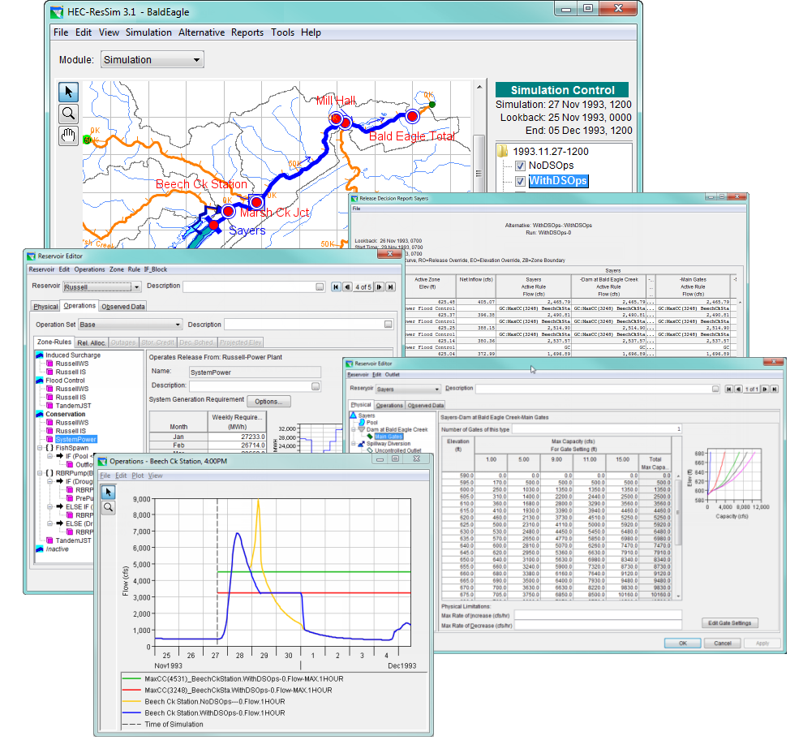
Approach
HEC-ResSim (Reservoir System Simulation) simulates reservoir operations at one or more reservoirs for:
Flood management
Low flow augmentation
Water supply
Applications:
Planning studies
Detailed reservoir regulation plan investigations
Real-time decision support
Notes:
Keep it simple and clear. Particularly with modeling efforts - the interaction of different models, modules and updates needs to be clear. Where in the grand scheme of things does this research fit?

Slide 8
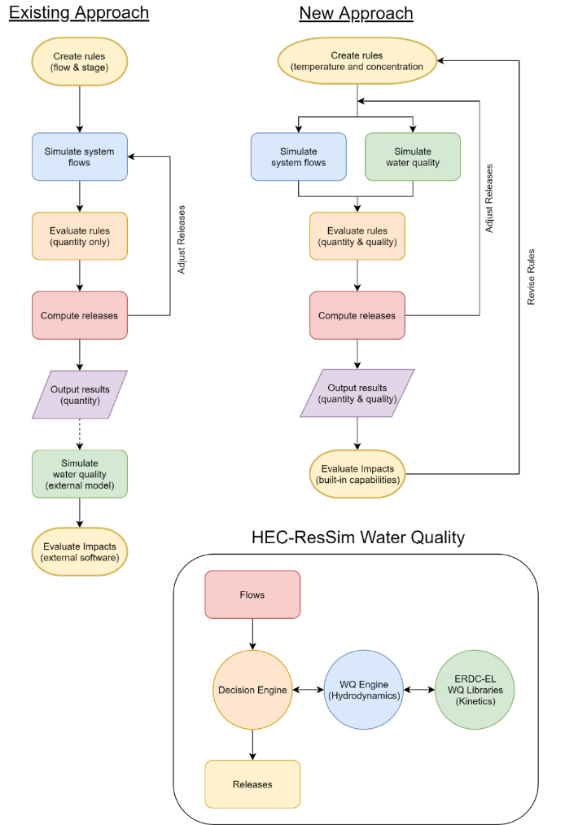
Approach
Existing Approach
WQ is simulated after computing the hydrology and release decisions.
WQ operation rules are specified indirectly (using stage and flow) to meet environmental objectives.
Environmental objectives are often combined with other objectives, like navigation, flood control, or hydropower.
If the desired environmental benefits of an alternative are not achieved, new guesses need to be made, and the simulation recomputed. This stage is often skipped altogether.
New Approach
WQ is simulated in parallel with the hydrology and release decisions
WQ operation rules can be specified directly (temperature, concentration, or load) to meet environmental objectives
Environmental objectives can be specified and managed independently of other objectives, clarifying the environmental impacts of operation decisions
(Manually)
Notes:
Keep it simple and clear. Particularly with modeling efforts - the interaction of different models, modules and updates needs to be clear. Where in the grand scheme of things does this research fit?

Slide 9
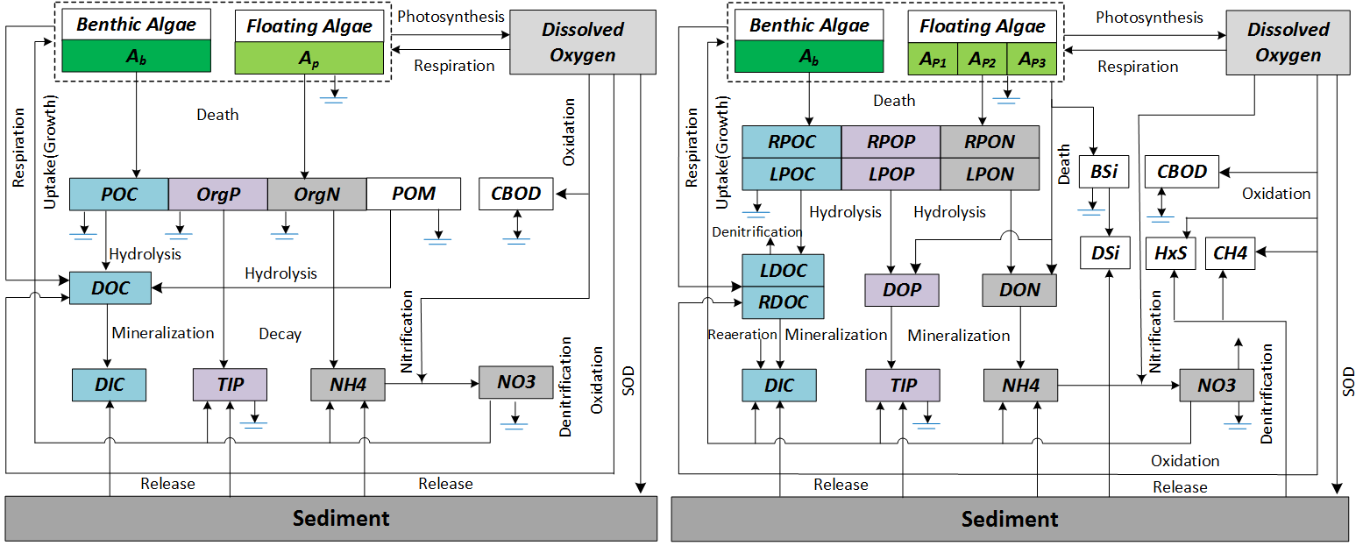
Approach
ClearWater Engine and Modules (Computational Library for Environmental Analysis and Restoration of Watersheds) :
ClearWater Water Quality Engine:
Hydrodynamics and transport
Communication with ResSim decision engine & WQ libraries
ClearWater Water Quality Modules:
Simulate vertically stratified water column
Plug-in interface for kinetics libraries:
Facilitate rapid future expansion of WQ capabilities
Leverage existing software:
ClearWater Modules
(Temperature, nutrients, etc.)
CE-QUAL-W2
HEC-RAS
HEC-5Q
Notes:
Keep it simple and clear. Particularly with modeling efforts - the interaction of different models, modules and updates needs to be clear. Where in the grand scheme of things does this research fit?

Slide 10
Collaboration & Communication Plan
Project Planning
Project is complete
Reporting
Giving bi-monthly presentations to USACE Districts to help select the appropriate model(s) for their studies. These include HEC-ResSim, CE-QUAL-W2, and HEC-RAS for river and reservoir systems.
Will teach HEC-ResSim-WQ workshops at conferences annually
Field Work Coordination
Will coordinate with field users on field data collection for future HEC-ResSim-WQ model applications

Slide 11
Scheduled Products
Scheduled Products
Description | Scheduled Due Date | Current Percent Complete | Projected Completion Date
 | (Qtr/Yr) | (%) | (Qtr/Yr)
1. Water quality software design document | Q4/FY16 | 100 | Q4/FY16
2. HEC-ResSim unit test program with 1D water quality capabilities (temperature, conservative constituent, and eutrophication) | Q4/FY17 | 100 | Q4/FY17
3. EL Water Quality libraries developed and ready to link with HEC-ResSim to provide eutrophication simulation capability (DO, nutrients, etc.) | Q3/FY17 | 100 | Q3/FY17
Notes:
Include all PRODUCTS/DELIVERABLES as specified in the original WU documentation

Slide 12
Scheduled Products
Scheduled Products
Description | Scheduled Due Date | Current Percent Complete | Projected Completion Date
 | (Qtr/Yr) | (%) | (Qtr/Yr)
4. Beta version: HEC-ResSim with full (temperature and eutrophication) 1D water quality simulation and analysis capabilities | Q3/FY18 | 100 | Q1/FY20
5. Software tested and ready to deploy | Q4/FY18 | 100 | Q4/FY20
6. Software documentation (user’s manual and applications guide) prepared | Q4/FY18 | 100 | Q4/FY20
Notes:
Include all PRODUCTS/DELIVERABLES as specified in the original WU documentation

Slide 13
Scheduled Products
Scheduled Products
Description | Scheduled Due Date | Current Percent Complete | Projected Completion Date
 | (Qtr/Yr) | (%) | (Qtr/Yr)
7. Deployment Version: HEC-ResSim with full (temperature and eutrophication) 1D water quality simulation and analysis capabilities, with documentation, posted to HEC and ERDC-EL websites | Q2/FY19 | 100 | Q4/FY21
8. Technical Transfer: Webinar demonstrations and working sessions | Q2/FY19 | 100 | Q4/FY20
9. Technical Transfer: Documentation posted to HEC and EL websites; reports and papers prepared | Q2/FY19 | 100 | Q4/FY20
Notes:
Include all PRODUCTS/DELIVERABLES as specified in the original WU documentation

Slide 14
Additional Products/Achievements¹
Additional Products/Achievements
Description | (Qtr/Yr)
1. Development of total dissolved gas (TDG) capability for NWD Columbia River NEPA analysis | Q3/FY17
2. HDF5 interface libraries built that can be used with Fortran, .Net (Visual Basic and C#), and Java. These libraries provide a user-friendly interface for exchanging data with HDF5 files. These general-purpose libraries can be used by HEC-ResSim, HEC-RAS, HEC-HMS, and other programs to store and retrieve hydrologic and environmental data. | Q4/FY17
3. Collaboration established with Sonoma County Water Agency (SCWA) to complete development of shared WQ engine. SCWA provided funding for WQ engine development and then applied HEC-ResSim for their Russian River WQ study in FY19. | Q4/FY18 Q4/FY19
4. Water quality web pages posted that provide an overview of the ERDC-HEC collaboration & WQ modeling software being developed. https://www.hec.usace.army.mil/software/waterquality | Q2/FY19

Slide 15
Additional Products/Achievements¹
Additional Products/Achievements
Description | (Qtr/Yr)
5. HEC-ResSim-WQ replaces the legacy HEC-5Q reservoir water quality model. HEC-5Q models that were developed for USBR and the State of California are being updated to HEC-ResSim-WQ (as well as CE-QUAL-W2) as a part of the Water Temperature Modeling Platform (WTMP) for the California Central Valley Project. | Q1/FY21

Slide 16
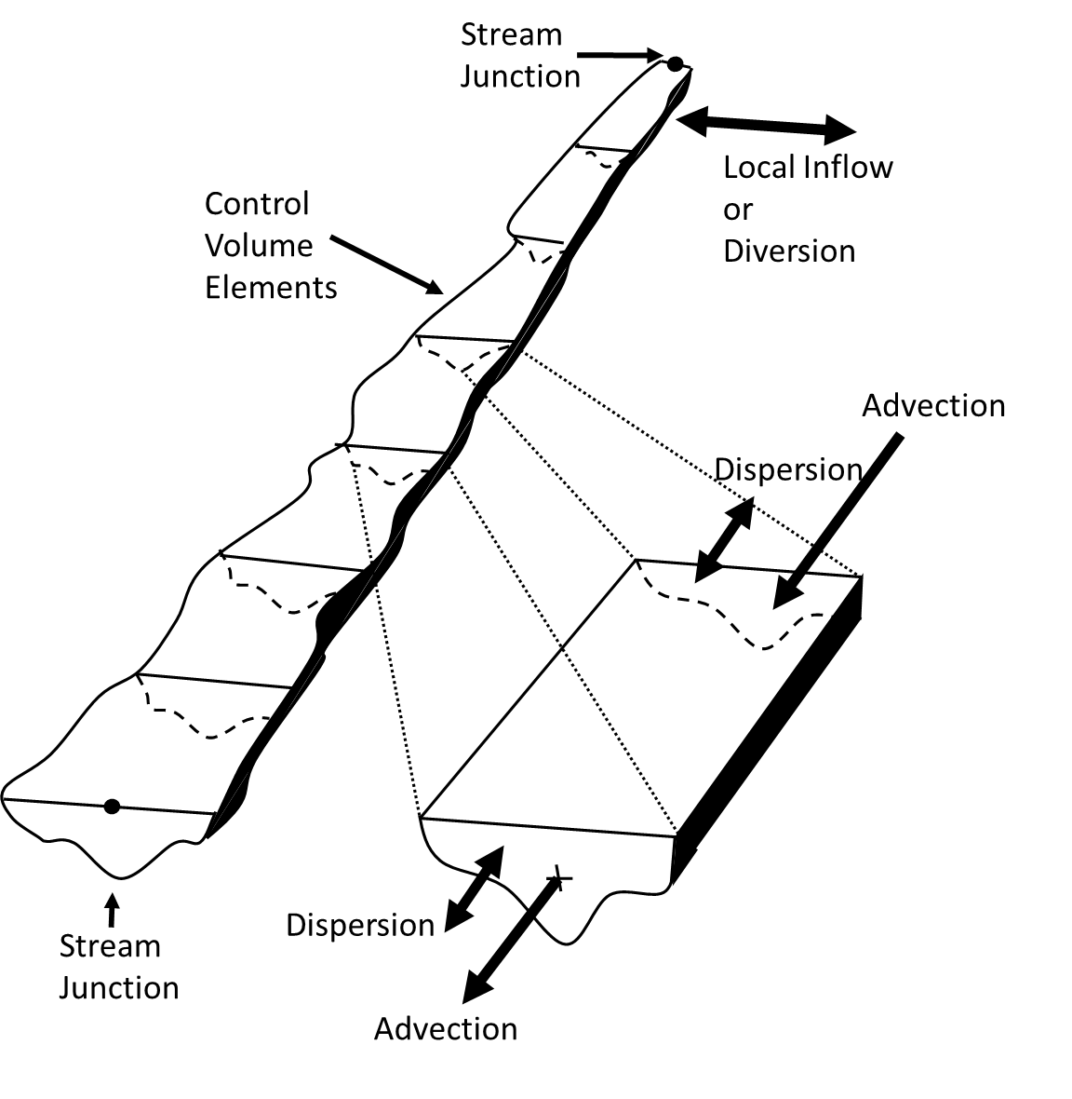
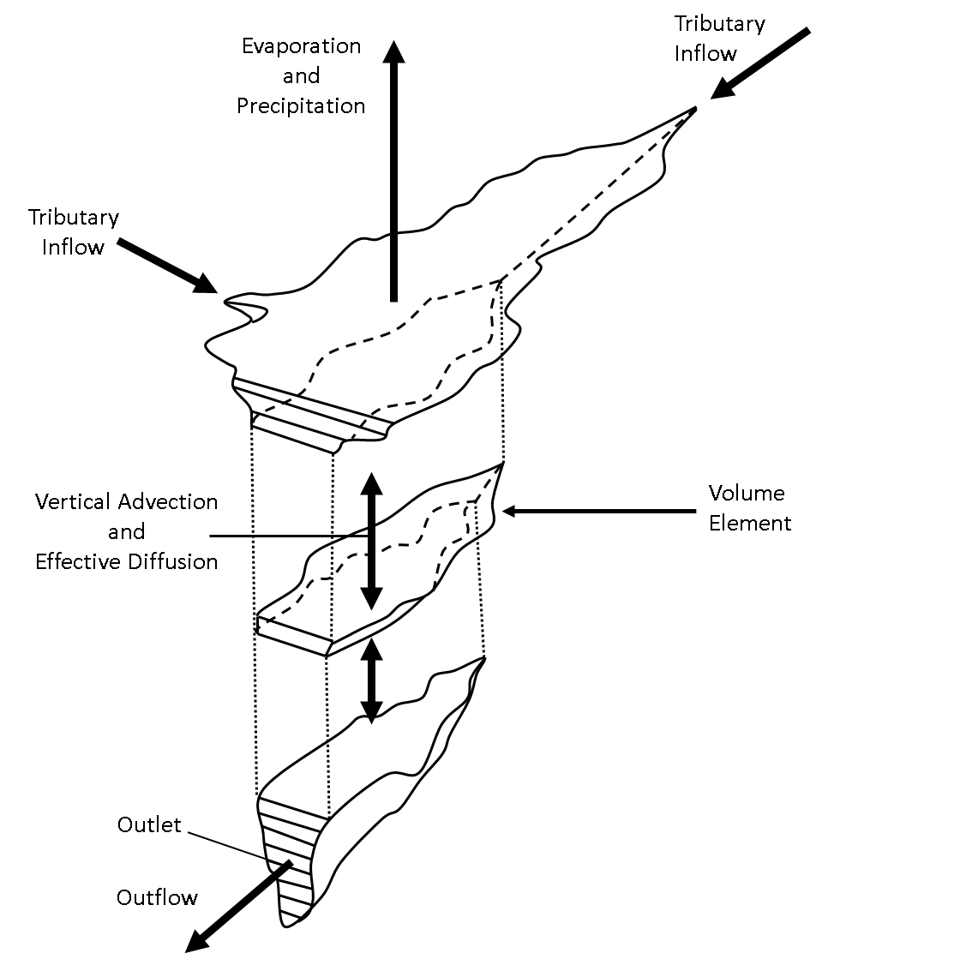

FY 16 - 21 Accomplishments Water Quality Transport Engine
$$\underset{\begin{aligned}\text{time} \\ \text{derivative}\end{aligned}}{\underbrace{\frac{∂C}{∂t}}}+ \underset{\text{advection}}{\underbrace{\frac{∂\left(vC\right)}{∂x}}} = \underset{\text{diffusion}}{\underbrace{\frac{∂}{∂x}\left(K\frac{∂c}{dx}\right)}} + \text{sources}\text{/}\text{sinks}$$
(1D)
Finite Volume Numerical Scheme
1D river reach with junctions
1D vertically stratified reservoir
Explicit solution scheme with sub-stepping
Cell face concentrations determined with 1st order upwind method, 2nd order flux-limiting method in testing.
Accept flows computed by hydraulic or hydrologic routing
1D Reach
1D Reservoir
RMA, “Generalized One-Dimensional Reservoir and River Water Quality Engine Prototype”, prepared for the USACE Hydrologic Engineering Center, November 2017
Notes:
Describe product and capability, importance/impact, etc.. Employ images generously. Tell a good story.

Slide 17
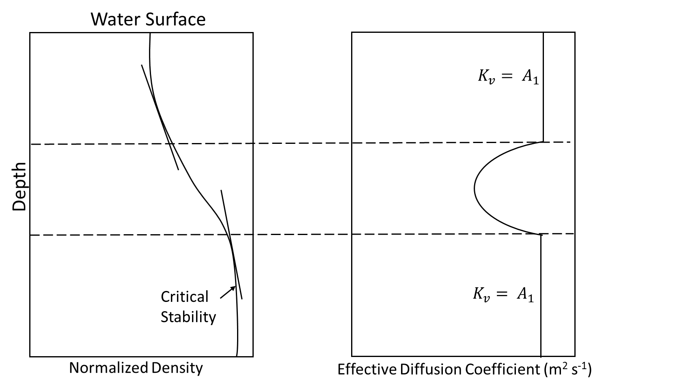

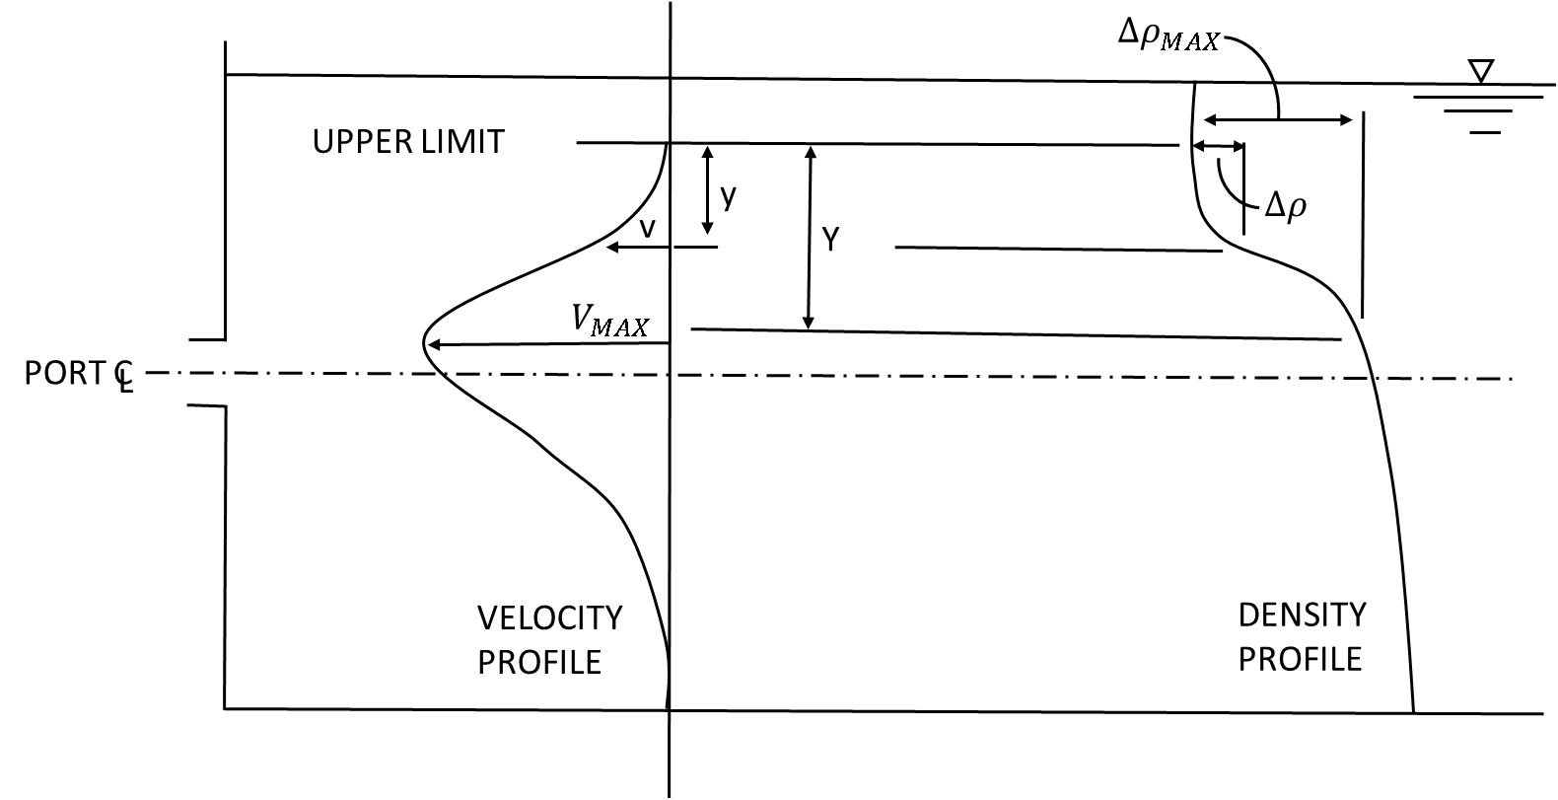
FY 16 - 21 Accomplishments Density-Stratified Reservoirs
Vertical Diffusion and Mixing Layers
Vertical diffusion and layer stability related to surface wind and density gradient, which is in turn a function of temperature, salinity, or suspended solids
Inflow Allocation
Determine reservoir layer with density equal to inflow density
If in upper or lower mixed zones (epilimnion or hypolimnion), distribute over zone
If in stratified zone, determine thickness of inflow zone
Withdrawal Allocation
Layers from which water is withdrawn is a function of the outlet elevation and size, density distribution, and flow rate
Methodologies adapted from
HEC-RAS-WQ, CE-QUAL-R1, CE-QUAL-W2, and HEC-5Q
u
x
z
Notes:
Describe product and capability, importance/impact, etc.. Employ images generously. Tell a good story.

Slide 18
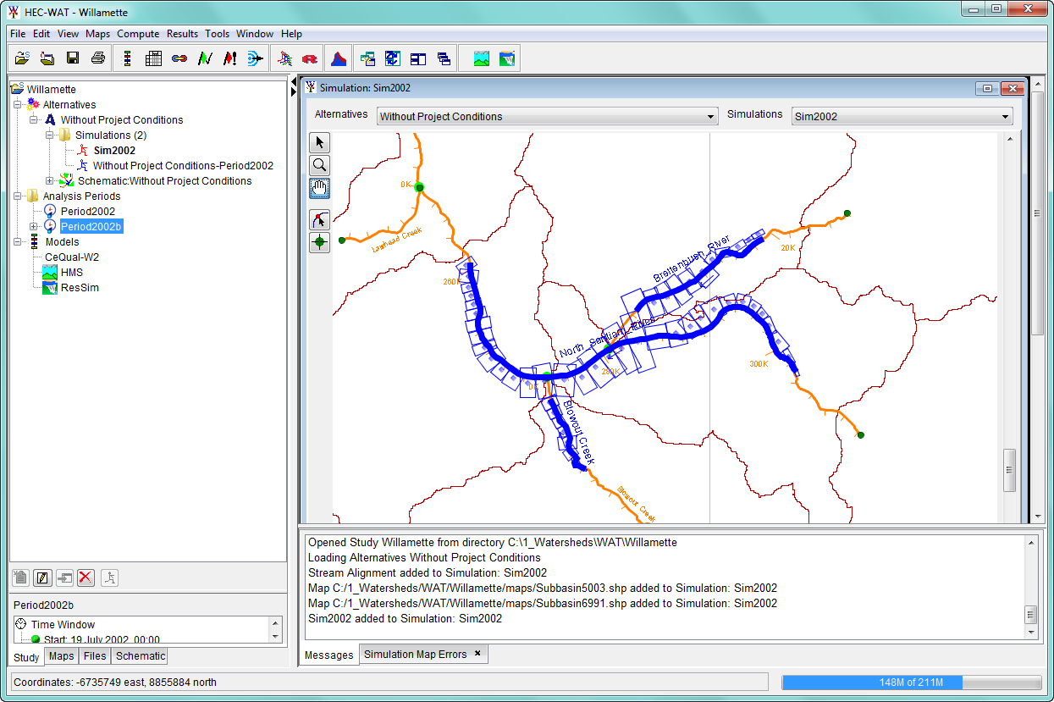
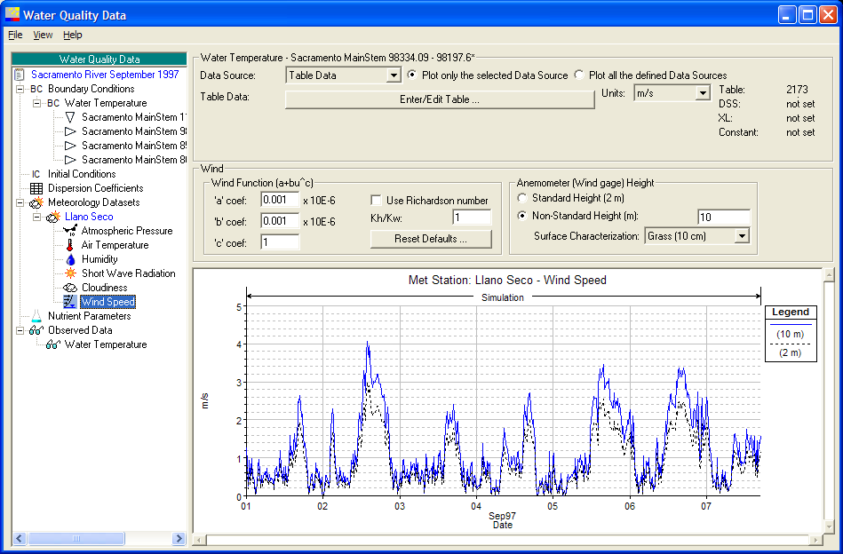
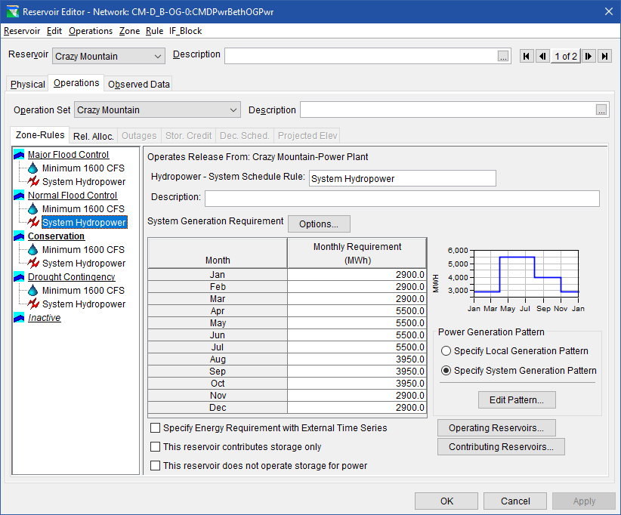
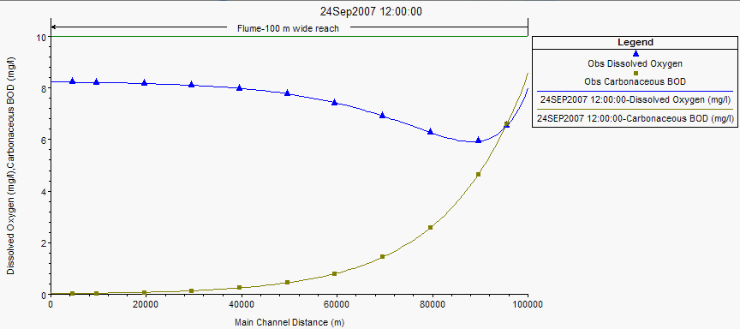
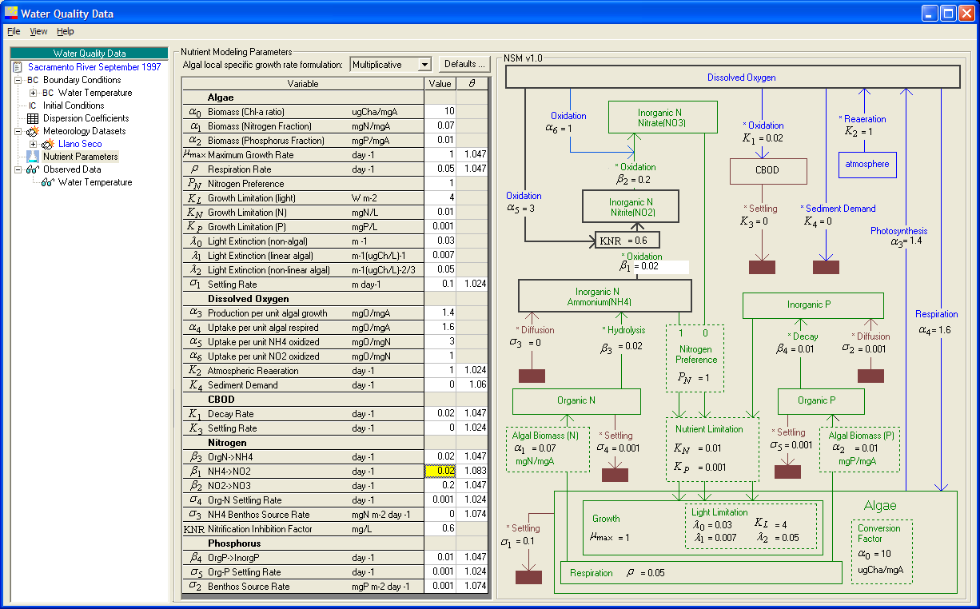
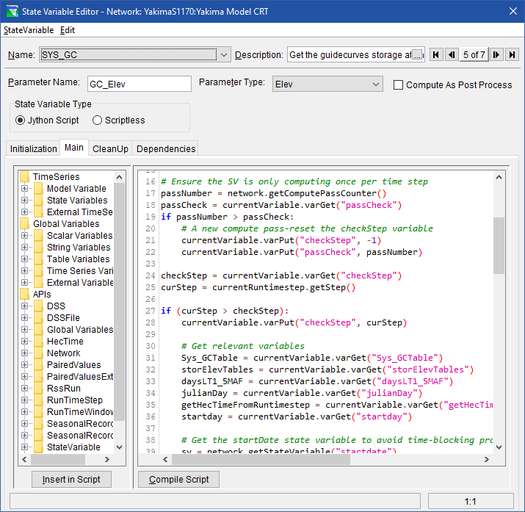
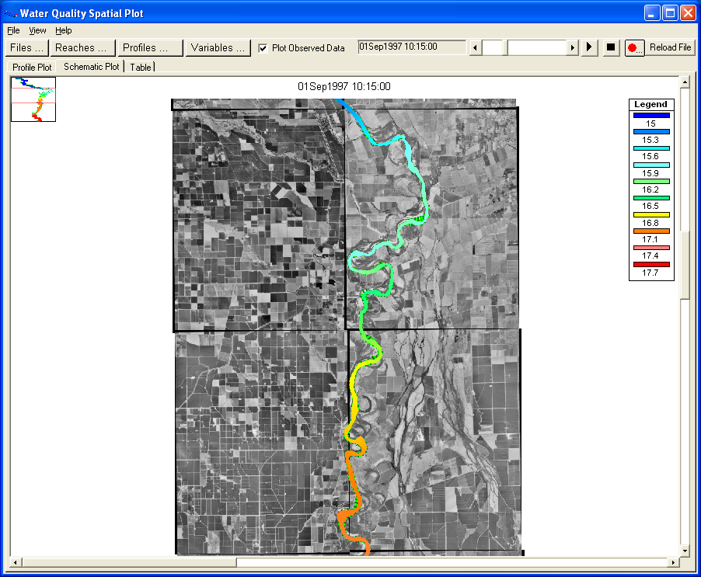
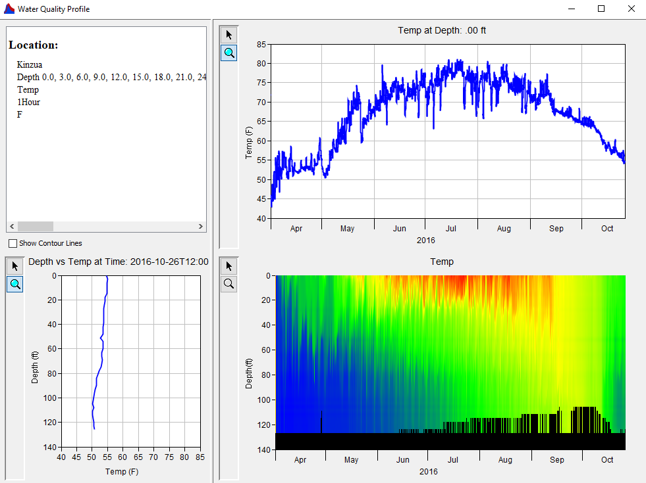
FY 16 - 21 Accomplishments Water Quality Modeling User Interface
Model Geometry
Specifying Boundary Conditions
Operating Rule Priorities
Constituent Relation Parameters
Visualization
Scripted Rules and State Variables
Notes:
Describe product and capability, importance/impact, etc.. Employ images generously. Tell a good story.

Slide 19
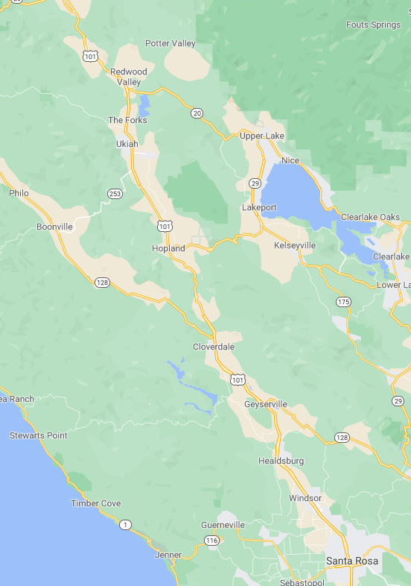
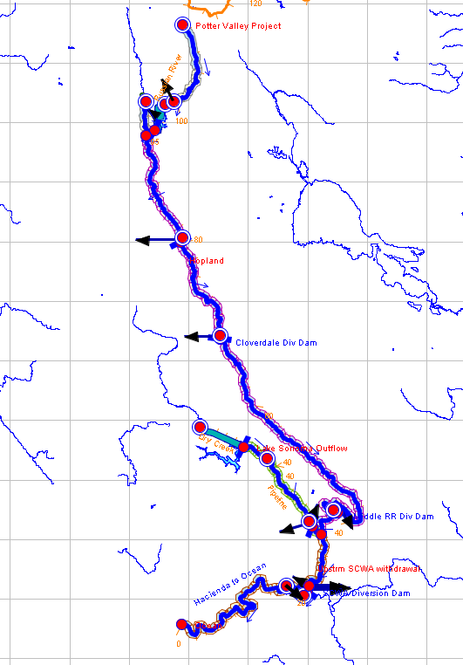
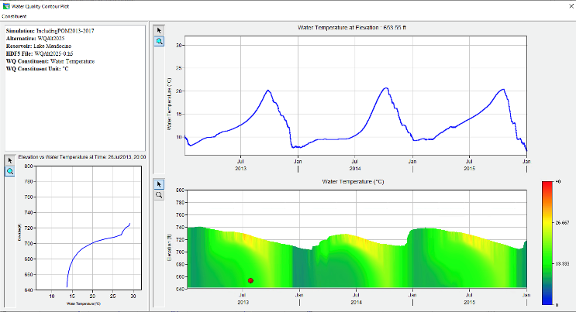
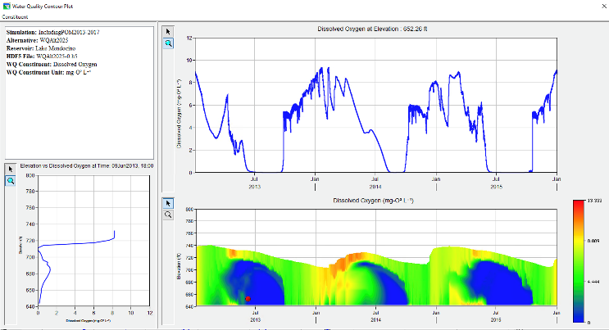
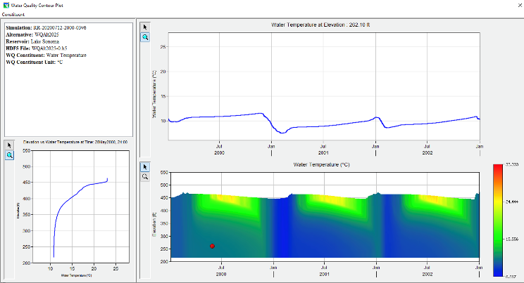
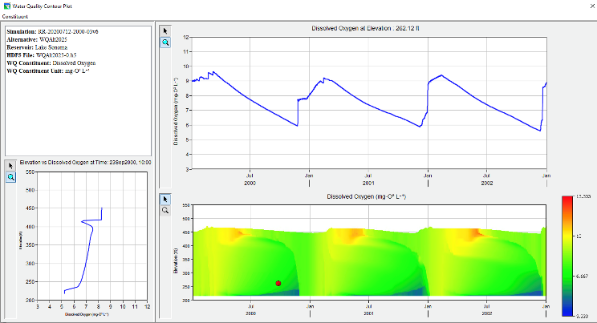
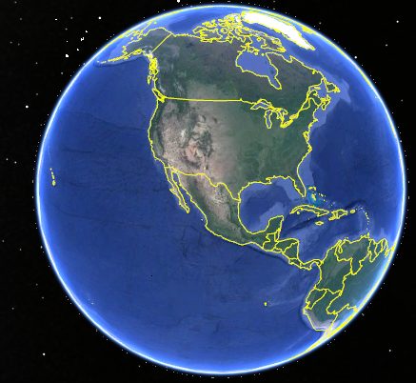
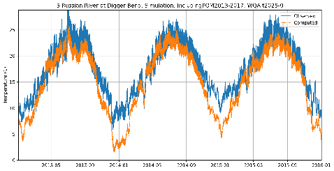
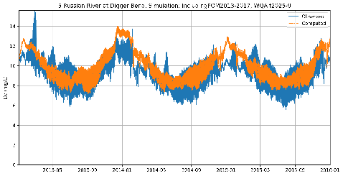
FY 16 - 21 Accomplishments Temperature and Dissolved Oxygen Russian River, California, Sonoma Water
Temperature
Dissolved Oxygen
Lake Mendocino
Lake Sonoma
Temperature
Dissolved Oxygen
Notes:
Describe product and capability, importance/impact, etc.. Employ images generously. Tell a good story.

Slide 20
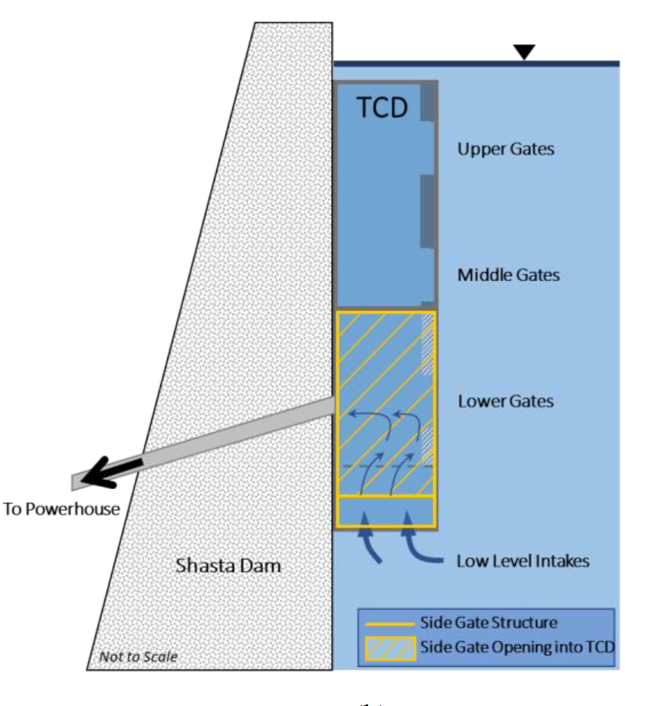
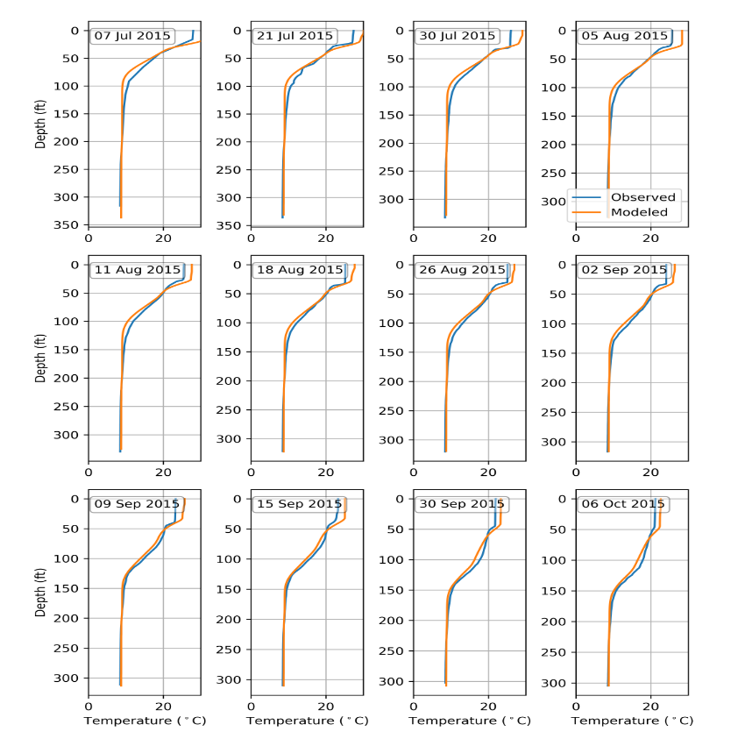
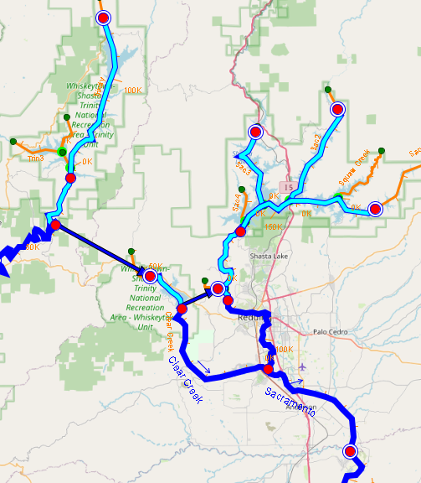
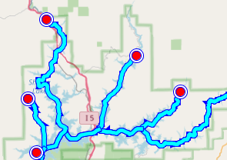
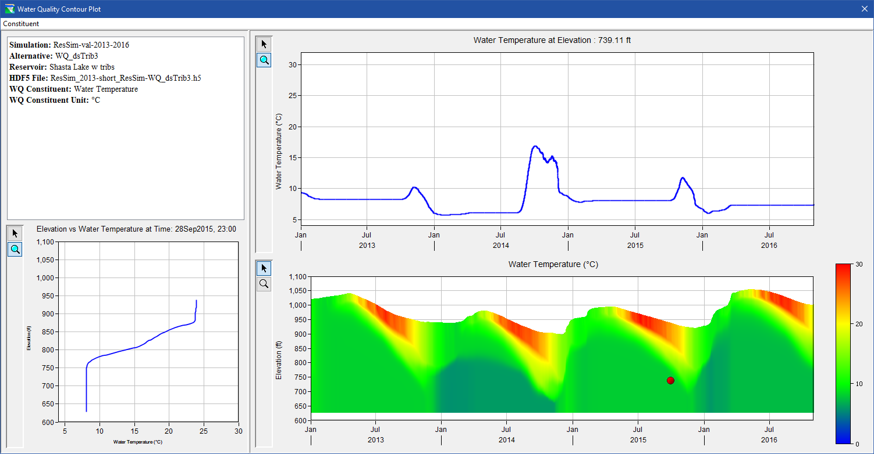
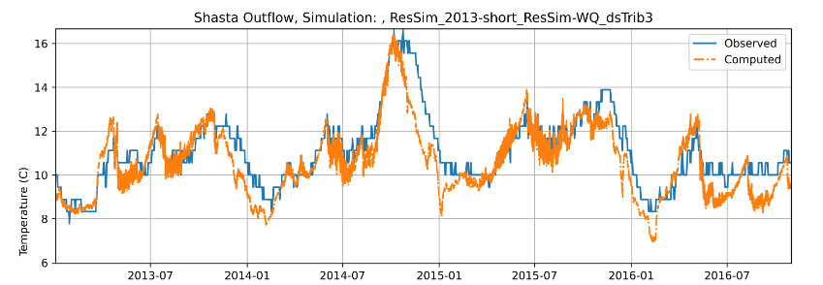
FY 16 - 21 Accomplishments River Temperature & Cold-Water Pool Management Upper Sacramento River, U.S. Bureau of Reclamation
Trinity Lake
Shasta Lake
Lewiston Dam
Shasta TCD graphic courtesy of Watercourse Engineering
Keswick Dam
Whiskeytown Lake
Notes:
Describe product and capability, importance/impact, etc.. Employ images generously. Tell a good story.

Slide 21
FY 21 Accomplishment Technical Transfer
The National Conference on Ecosystem Restoration (NCER), Virtual, July 2021
Organized two sessions:
Water Quality Modeling Software Development
Water Quality Modeling Applications/Studies
Abstract accepted, American Geophysical Union (AGU) Conference, December 2021
Notes:
Describe product and capability, importance/impact, etc.. Employ images generously. Tell a good story.

Slide 22
Synopsis
Funding
FY16 $300K
FY17 $300K
FY18 $300K
FY19 $300K
FY20 $50
Project $1,250K
Project Status
Complete
Project Focus
ResSim Water Quality (WQ) capabilities have been implemented
Other Comments
Collaborated with HEC-HMS team on shared WQ engine development
Additional development was funded by the Sonoma County Water Association (SCWA) for the Russian River Study
The USBR used HEC-ResSim-WQ to develop the Water Temperature Modeling Platform (WTMP) for the California Central Valley Project. HEC-ResSim-WQ models were linked with CE-QUAL-W2 models and observed data.
USBR funded developing HEC-ResSim-WQ models to replace their legacy HEC-5Q models.
Notes:
Funding for all FY’s funded

Slide 23
Summary
Water quality capabilities have been implemented in HEC-ResSim.
ClearWater Engine and modules, shared with HEC-HMS
Temperature and eutrophication modeling capabilities
User Interface for model setup, data input/output, visualization/analysis of results
Compatible with HEC integration software packages HEC-WAT and CWMS/RTS
New UI components support configuration of WQ models & interpretation of results
Two case studies were prepared to demonstrate some of the new WQ capabilities
Temperature, nutrients, primary production, and dissolved oxygen simulation for the Russian River, CA
Temperature simulation for the upper Sacramento System, CA
Workshop was replaced with demonstrations and working sessions:
Due to time constraints and travel restrictions, field users requested periodic follow-up demonstrations (1-2 hours) instead of a workshop.
District partners suggested that an in-person or virtual working session be scheduled prior to initiating a WQ modeling project.

